Slide 1
Ecphrastic poetry & the development of professional literacy in mathematics

Slide 2
What is ecphrastic poetry?
Ecphrastic poetry is the conversation between two pieces of art. The writer interprets a work of visual art and then creates a narrative in verse form that represents his or her reaction to that painting, photograph, sculpture or other artistic creation.
http://www.firkinfiction.com/11.html

Slide 3
Ecphrastic poetry and mathematics
How do you write a mathematics-related in an ecphrastic manner?
Complete the following steps:
  View a stimulus image and identify a mathematics-related concept it evokes.
  If required, write down the concept, definition, law, formula etc.
  Identify a suitable poetry type and write the poem.

Slide 4
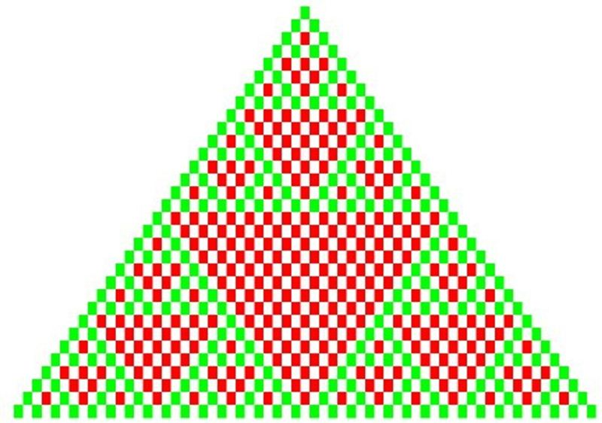
What concept does this image evoke?
http://www.techtone.me/images/math-and-geometry/pascals-triangle/PascalModulus2_thumb.jpg/

Slide 5
Pascal‘s Triangle

Slide 6
Example Haiku poem
Pascal’s Triangle:
writing it out is a chore.
How fast does it grow?
http://mathlesstraveled.com/2007/12/28/carnival-of-mathematics-23-haiku-edition/

Slide 7
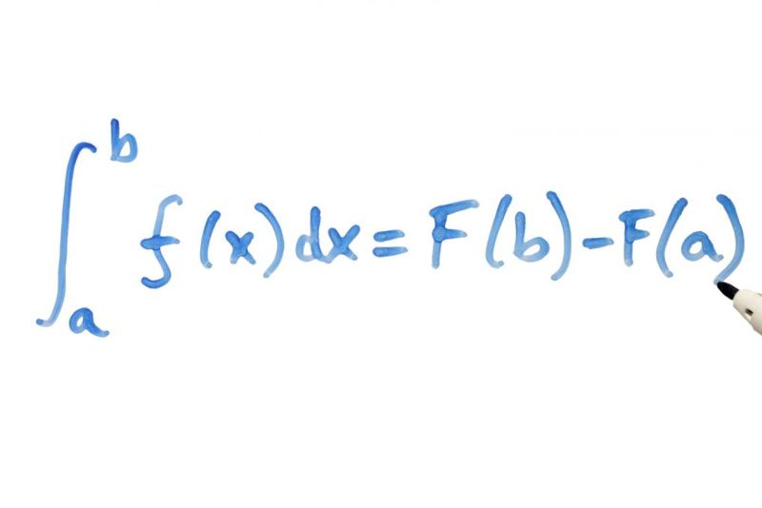
What concept does this image evoke?
http://compellingparade.com/wp-content/uploads/2011/06/calculus.jpg

Slide 8
Anti-derivatives and calculus

Slide 9
Example Limerick poem
A calculus student upset as could be
That his anti-derivative just didn't agree
With the answer in the book
Even after a second look
Indeed it was off, but by a constant C.
http://jcdverha.home.xs4all.nl/scijokes/1_4.html#subindex

Slide 10
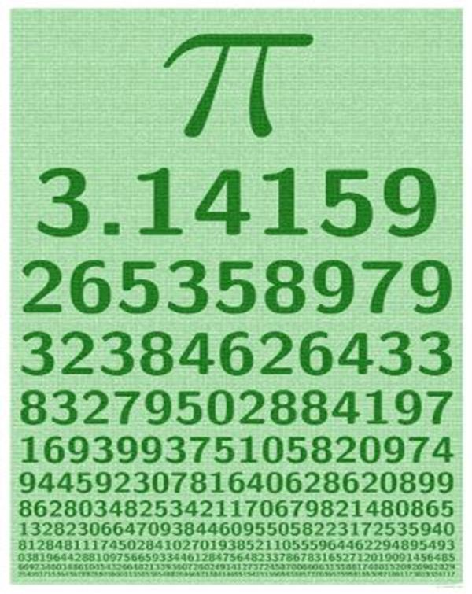
What concept does this image evoke?
http://www.cartoonstock.com/newscartoons/cartoonists/rmr/lowres/rmrn14l.jpg

Slide 11
PI‘s relationship to circle-related calculations (circumference, area etc.)

Slide 12
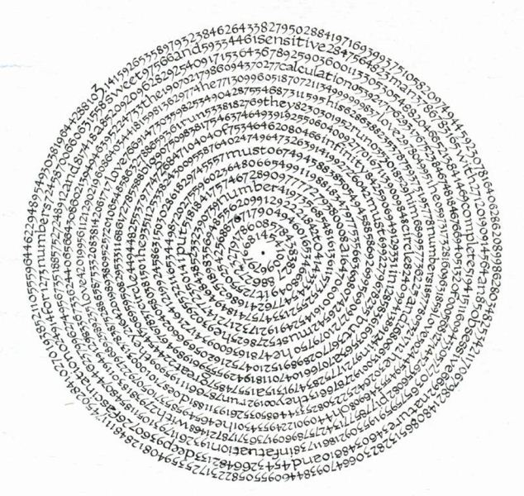
Example concrete poem
http://talklikeaphysicist.com/wp-content/uploads/2008/03/pi-caligraphy.jpg

Slide 13
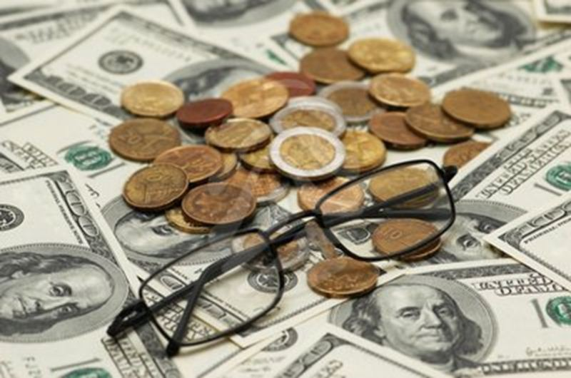
What concept does this image evoke?
http://generic.pixmac.com/4/royalty-free-images-american-dollars-reading-glasses-and-various-coins-42737097.jpg

Slide 14
Currency denominations

Slide 15
Example free verse poem
Penny, penny, easy spent,
Copper brown and worth one cent.
Nickel, nickel, thick and fat,
You’re worth 5. I know that.
Dime, dime, little and thin,
I remember—you’re worth 10.
Quarter, quarter, big and bold,
You’re worth 25, I am told.
Half a dollar, half a dollar,
Giant size.
50 cents to buy some fries.
Dollar, dollar, green and long,
With 100 cents you can’t go wrong.
http://myteacherpages.com/webpages/jgriffin/gazillion.cfm?subpage=25701

Slide 16
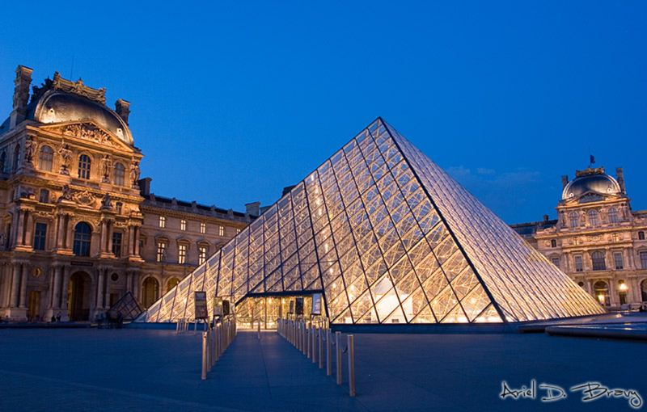
What concept does this image evoke?
http://www.arielbravy.com/photoblog/images/20060305233752_entrance%20to%20the%20louvre.jpg

Slide 17
Properties of triangles

Slide 18
Example cinquain poem
triangles
pointy edges
revolving, rotating, angling
Triangles are all different.
180°
http://courses.missouristate.edu/ShaeJohnson/CinquainPoetryInstrucandEx.htm

Slide 19
Example acrostic
Acute angles are less than ninety degrees.
Neither an acute angle nor an obtuse angle is a right angle.
Greater than 90° and less than 180° are obtuse angles.
Like their arcs of 60°, circle's central angles also have 60°.
Equivalent angles like vertical angles are congruent.
Supplementary angles are a pair of angles that add to 180°
http://answers.yahoo.com/question/index?qid=20080417153207AAuDyvY

Slide 20
What concept does this musical composition evoke?
French nusery melody, Frère Jacques.

Slide 21
Geometrical shapes

Slide 22
Example re-worked song lyrics
This is a square, this is a square
How can you tell? How can you tell?
It has four sides, all the same size
It's a square; it's a square
This is a circle, this is a circle
How can you tell? How can you tell?
It goes round and round, no end can be found
It's a circle; it's a circle
http://myteacherpages.com/webpages/jgriffin/gazillion.cfm?subpage=25701c

Slide 23
Activity
Using the given stimulus material, create the following types of poetry:
Free verse
Acrostic
Cinquain
Haiku
Limerick

Slide 24
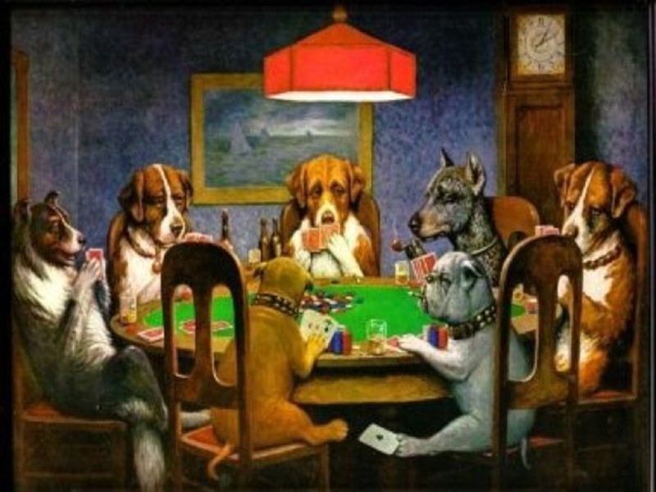
STIMULUS IMAGE 1
http://hphotos-snc1.fbcdn.net/hs248.snc1/9533_1251113879374_1275310067_753434_5348274_n.jpg

Slide 25
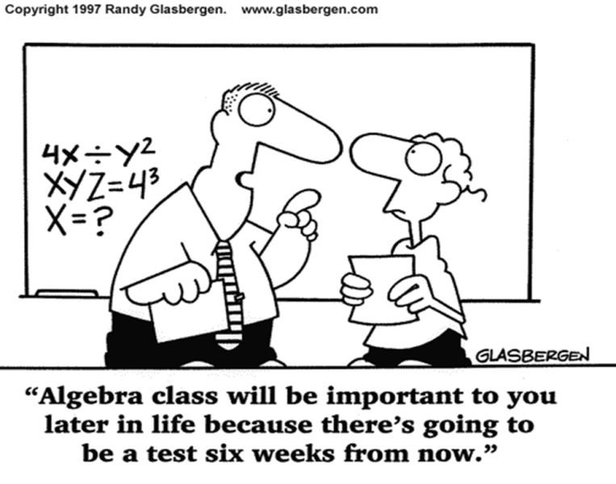
STIMULUS IMAGE 2
http://cfftjresources.wikispaces.com/file/view/algebra_cartoon.gif/194634384/algebra_cartoon.gif

Slide 26
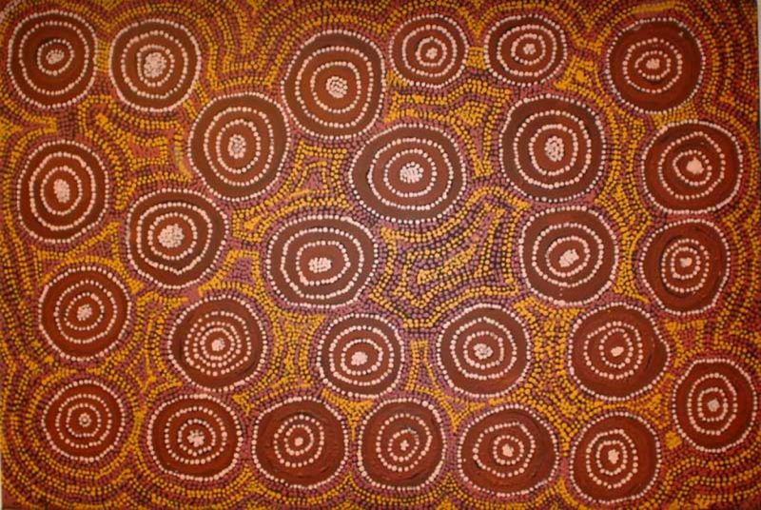
STIMULUS IMAGE 3
http://www.aboriginalartshop.com/aboriginal%20painting%20-%20dotting.jpg

Slide 27
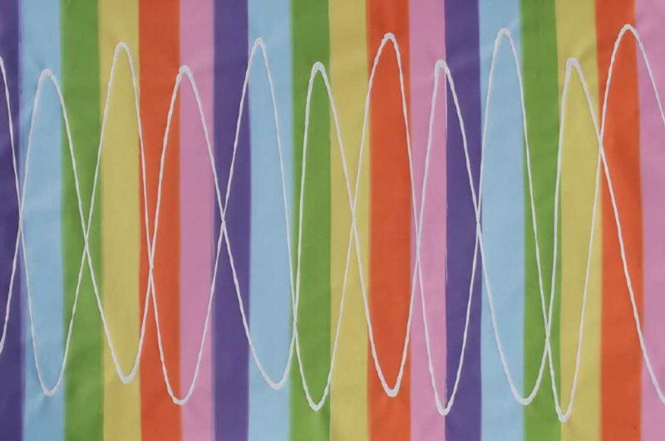
STIMULUS IMAGE 4
http://www.pendulumpainter.com/sinewavewholelores.jpg

Slide 28
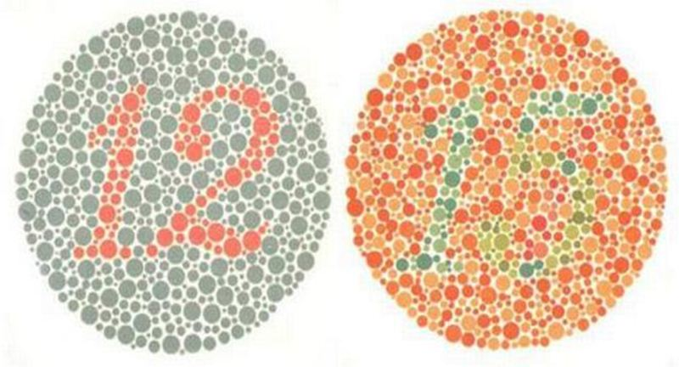
STIMULUS IMAGE 5
http://www.thehindu.com/multimedia/dynamic/00004/ColourBlindness_4671f.jpg

